Slide 1



Facebook EDA
INSAID- Term2 Project
By: Sudha Udayakumar
5th October 2020
Notes:
https://www.freepik.com/free-vector/people-doing-different-actions_3521084.htm
https://www.freepik.com/free-vector/hand-drawn-people-doing-outdoor-activities_2620727.htm

Slide 2



Agenda
1
Data Profiling and Processing
2
Facebook User Gender Analysis
Gender-wise User count vs Duration as Facebook user
3
Age-wise analysis, Duration wise analysis
4
Inactive users
5
Summary- SWOT Analysis
6
Actionable Insights

Slide 3
Data Profiling and Processing
Gender/Duration – Null values for have not been added in the data.
Age – Users above the age of 100 were not considered for analysis
Inactive Users – This data has been analysed separately

Slide 4
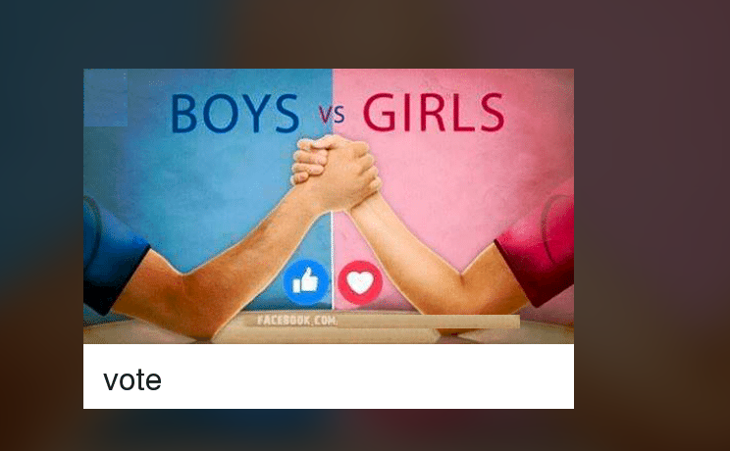
Gender Usage
Notes:
Photo by William Poulos on Unsplash

Slide 5
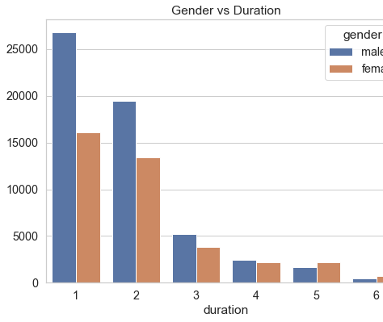
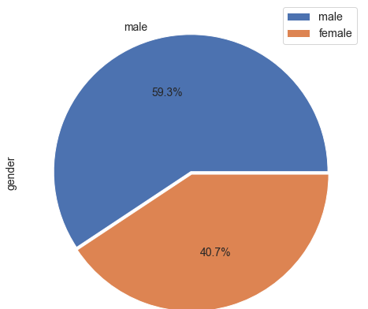
Facebook User Gender Analysis
Gender-wise User count vs Duration as Facebook user

Slide 6
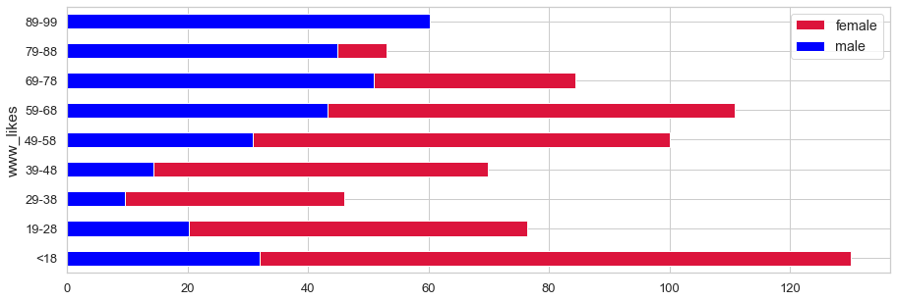
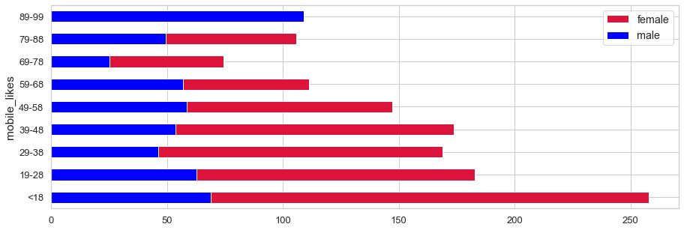
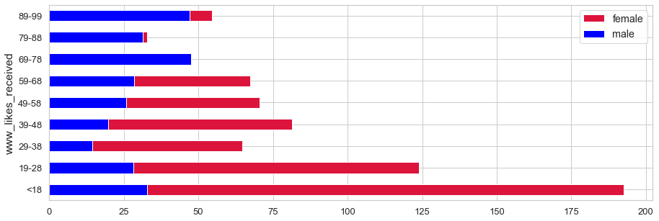
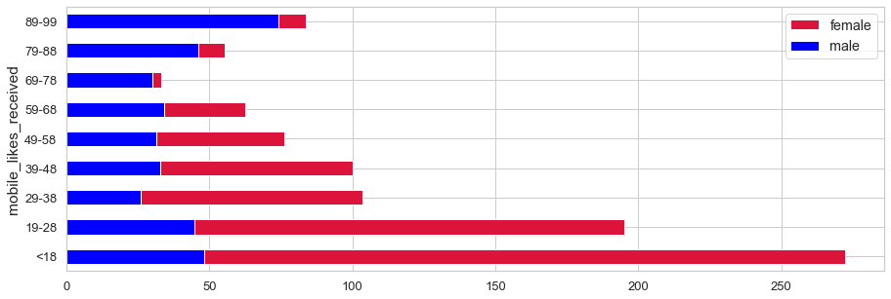
Age-wise grouping vs Web Likes given, Mobile Likes given, Web Likes received & Mobile likes received
Women have received and given more likes in both web and mobile. Mobile usage is seen to be higher than Web across multiple age groups.

Slide 7
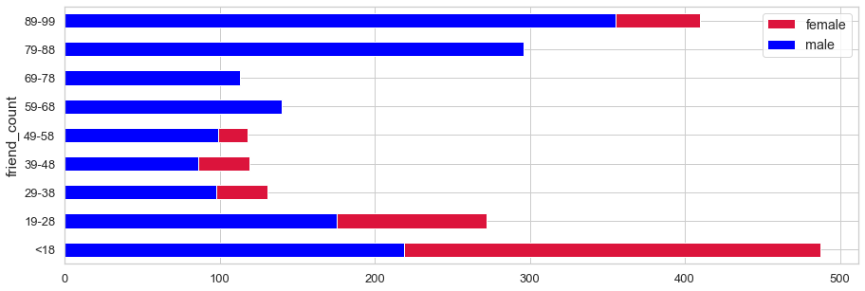
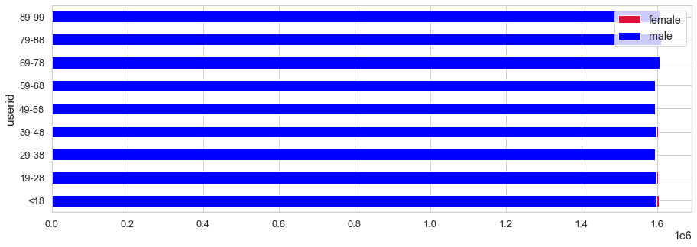
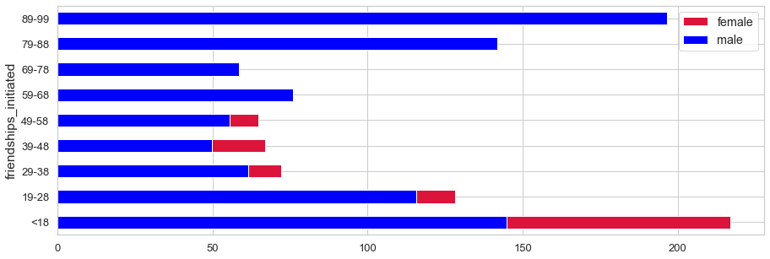
Age-wise grouping vs Friend Count, Friendship initiated and User count
Though Men users are higher, Women have more friends and have initiated a greater number of friend request. This is the pattern until the 48 to 58 age bucket. Post this men seem to start catching up.

Slide 8

Fb – Duration of usage

Slide 9
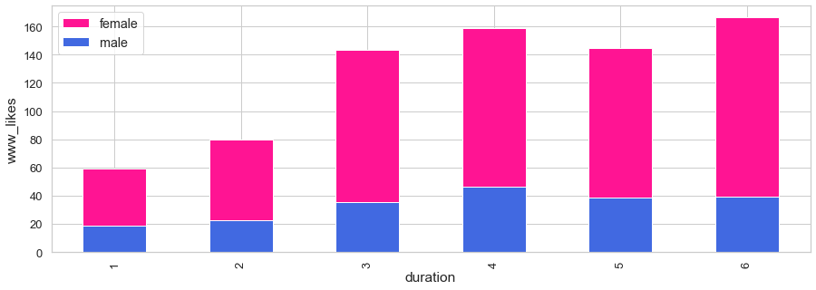
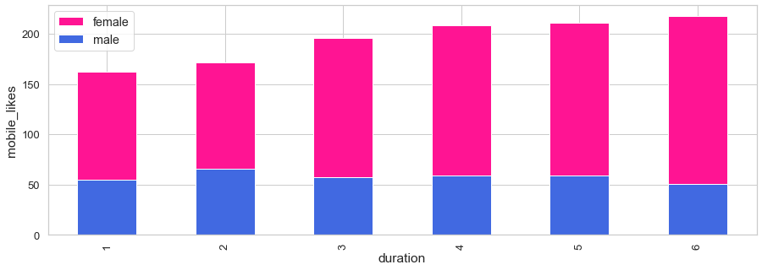
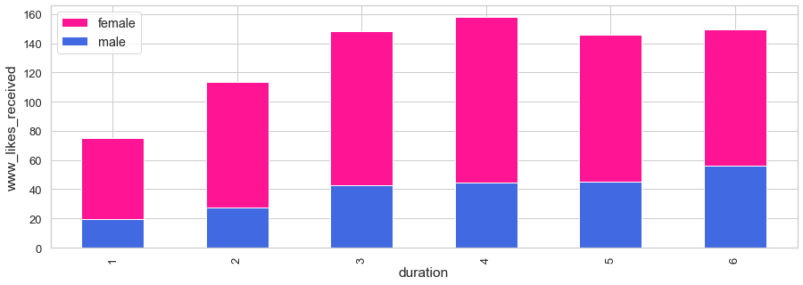
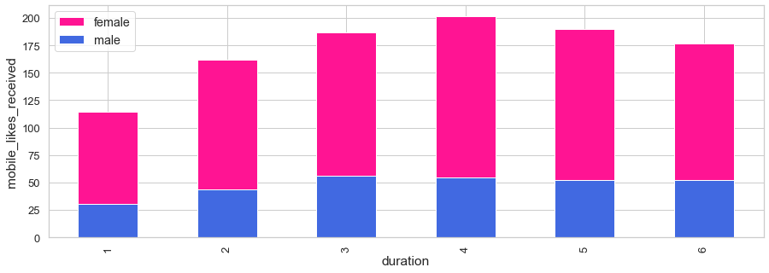
Duration as FB User grouping vs Web Likes, Mobile Likes, Web Likes received & Mobile likes received
Web likes is seen to increase across duration and dip after 4 years. Mobile likes however continue to increase after 4 years as well. Wrt to Likes received, the count dips after 4 years for both mobile and web users. Women continue to be the highest users

Slide 10
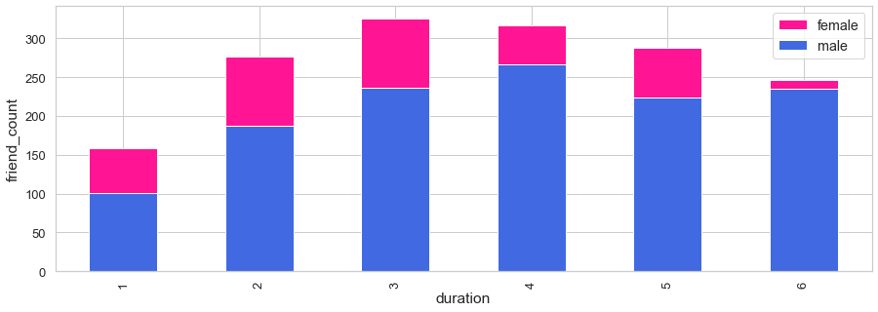
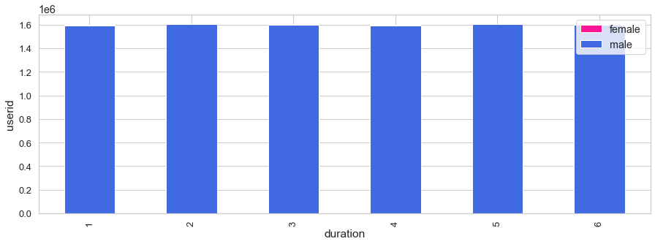
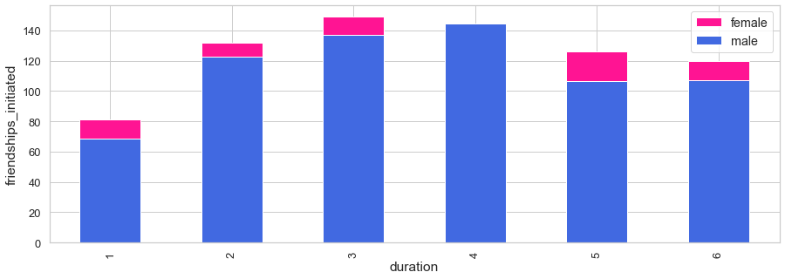
Duration as FB User grouping vs Friend Count, Friendships Initiated and User count
Friends count and Friendship initiated is seen to gradually increase until 3 years duration and then gradually dip for both men and women.

Slide 11
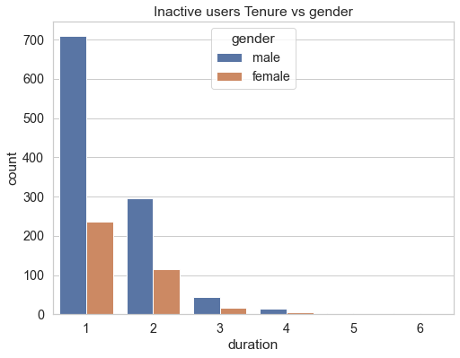
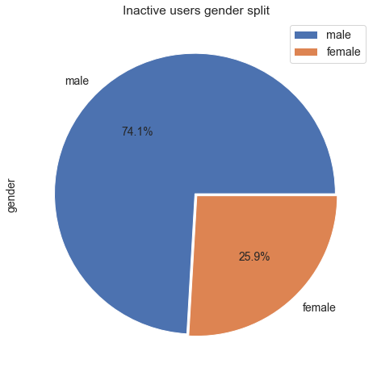
Inactive Facebook User Analysis
Gender-wise Inactive User count vs Duration as Facebook user
Men are generally inactive and also their inactivity is higher during the first 2 years

Slide 12




Summary - SWOT
Strength
Weakness
S
W
Women, minors and the younger workforce are active users
Men though high in number are not active in comparison with women
Opportunity
O
T
Threat
Though mobile app was launched after web format of FB, the users have adapted to Mobile
Users post 5 years have significantly dropped in usage.

Slide 13
Actionable Insights
Men usage can be increased by bringing in more engaging activities like Live sports, Men clubs etc
Senior citizens can be retained by bringing in more family related entertainment or health related activities for their use
Rewards can be introduced for sharing, commenting or liking a friend's post
Monetary bonuses can be introduced for posts with high likes, views or following.
Auto suggestions for friend/groups additions for people with similar likes and interests e.g. movies or gardening
Notes:
https://www.freepik.com/free-vector/social-influencer-background_3466233.htm
https://www.freepik.com/free-vector/social-media-elements_2795653.htm

Slide 14
Thank You!

